Slide 1
Indifference curve

Slide 2
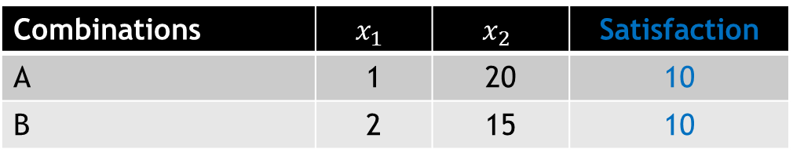

Indifference Curve
An indifference curve (IC) shows the different combinations of $x_{1}$ and $x_{2}$ that yield equal satisfaction to the consumer
Combinations | $$x_{1}$$ | $$x_{2}$$ | Satisfaction
A | 1 | 20 | 10
B | 2 | 15 | 10

Slide 3
Assumptions
An ordinal approach
Rationality of consumer
Non-satiety: consumer is not oversupplied with goods in question
Transitivity of choice
Consistency of choice
Diminishing marginal rate of substitution

Slide 4
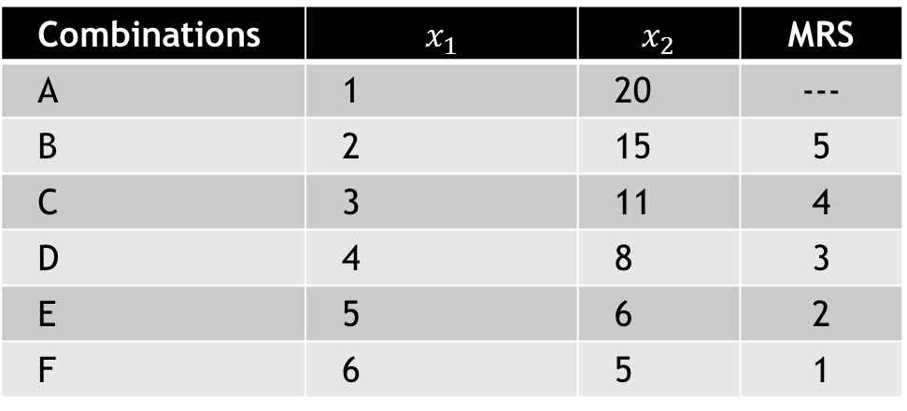
IC schedule
Combinations | $$x_{1}$$ | $$x_{2}$$ | MRS
A | 1 | 20 | ---
B | 2 | 15 | 5
C | 3 | 11 | 4
D | 4 | 8 | 3
E | 5 | 6 | 2
F | 6 | 5 | 1

Slide 5
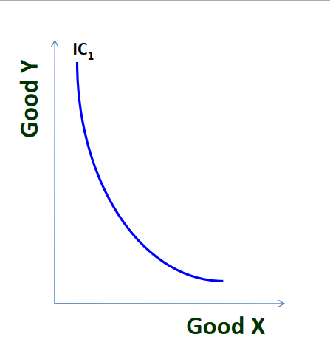
Graphical representation

Slide 6
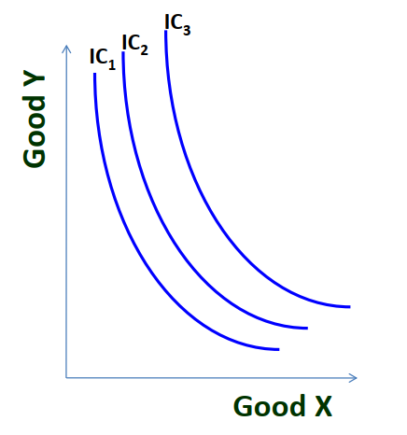
IC Map

Slide 7
Marginal rate of substitution
The rate at which an individual must give up good 1 in order to obtain one more unit of good 2, while keeping their overall satisfaction level constant
MRS keeps declining since consumer has more and more units of one good , he gives up less units of other goods.

Slide 8
Properties of IC
Negative slope
Always convex to the origin
Two IC never intersect each other
Higher IC shows higher level of satisfaction

Slide 9
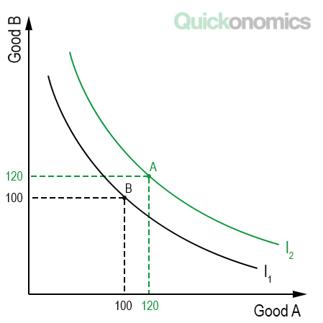
Properties of IC
Higher IC shows higher level of satisfaction
More goods are preferred to less goods
Higher IC contains more of either one or both goods
45
140

Slide 10
Properties of IC
Downward sloping
Implies that when the amount of one good in combination is increased, the amount of other good is reduced
This is essential if the level of satisfaction is to remain the same on an IC
Convex to the origin
Two commodities are imperfect substitute for each other
MRS between the two goods decreases when consumer moves along an IC

Slide 11
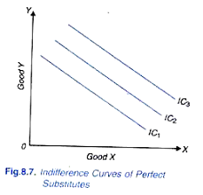
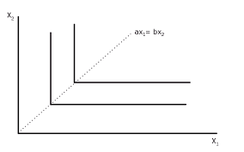
Two extreme conditions
When two goods are perfect substitute, IC will be a straight line
When two goods are complementary, IC will be L shaped

Slide 12
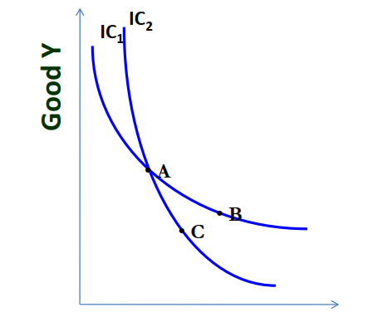
Two ICs never intersect each other

Slide 13
Consumer equilibrium
Consumer is in equilibrium when he is deriving maximum satisfaction from the goods and:
He is in no position to re-arrange his purchase of goods

Slide 14
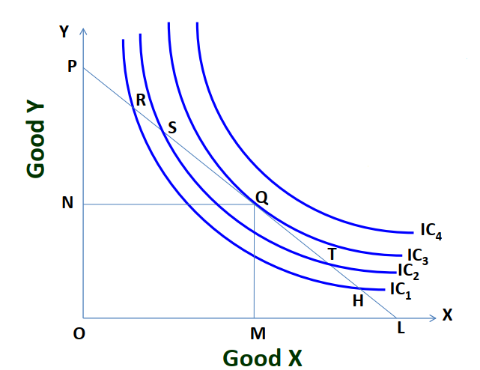
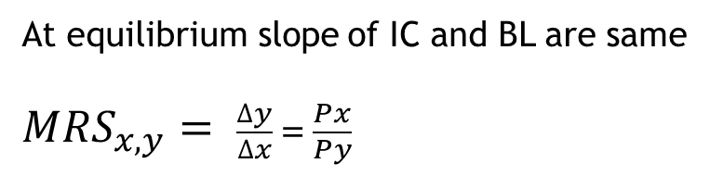
Consumer equilibrium
At equilibrium slope of IC and BL are same
${MRS}_{x,y}= \frac{∆y}{∆x} = \frac{Px}{Py}$

